Slide 1
Transverse Motion
Eric Prebys, FNAL

Slide 2
The Journey Begins…
We will tackle accelerator physics the way we tackle most problems in classical physics – ie, with 18th and 19th century mathematics!
Calculate ideal equilibrium trajectory
Use linear approximations for deviations from this trajectory
Solve for motion
Treat everything else as a perturbation to this
As we discussed in our last lecture, the linear term in the expansion of the magnetic field is associated with the quadrupole, so let’s start there…

Slide 3
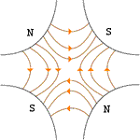
Quadrupole Magnets*
A positive particle coming out of the page off center in the horizontal plane will experience a restoring kick
*or quadrupole term in a gradient magnet

Slide 4
What about the other plane?
Defocusing!
Luckily, if we place equal and opposite pairs of lenses, there will be a net focusing regardless of the order.
➔pairs give net focusing in both planes -> “FODO cell”

Slide 5
Transfer matrices
The simplest magnetic lattice consists of quadrupoles and the spaces in between them (drifts). We can express each of these as a linear operation in phase space.
By combining these elements, we can represent an arbitrarily complex ring or line as the product of matrices.
Quadrupole:
Drift:

Slide 6
Example: FODO cell
At the heart of every beam line or ring is the “FODO” cell, consisting of a focusing and a defocusing element, separated by drifts:
The transfer matrix is then
L
L
f
-f

Slide 7
Where we’re going…
It might seem like we would start by looking at beam lines and them move on to rings, but it turns out that there is no unique treatment of a standalone beam line
Depends implicitly in input beam parameters
Therefore, we will initially solve for stable motion in a ring.
Rings are generally periodic, made up of more or less identical cells
In addition to simplifying the design, we’ll see that periodicity is important to stability
The simplest rings are made of dipoles and FODO cells
Or “combined function magnets” which couple the two
Periodic “cell”
Our goal is to de-couple the problem into two parts
The “lattice”: a mathematical description of the machine itself, based only on the magnetic fields, which is identical for each identical cell
A mathematical description for the ensemble of particles circulating in the machine (“emittance”);

Slide 8
Quick Review of Linear Algebra
In the absence of degeneracy, an nxn matrix will have n “eigenvectors”, defined by:
Eigenvectors form an orthogonal basis
That is, any vector can be represented as a unique sum of eigenvectors
In general, there exists a unitary transformation, such that
Because both the trace and the determinant of a matrix are invariant under a unitary transformation:

Slide 9
Stability Criterion
We can represent an arbitrarily complex ring as a combination of individual matrices
We can express an arbitrary initial state as the sum of the eigenvectors of this matrix
After n turns, we have
Because the individual matrices have unit determinants, the product must as well, so

Slide 10
Stability Criterion (cont’d)
We can therefore express the eigenvalues as
However, if a has any real component, one of the solutions will grow exponentially, so the only stable values are
Examining the (invariant) trace of the matrix
So the general stability criterion is simply

Slide 11
Example
Recall our FODO cell
Our stability requirement becomes
L
L
f
-f

Slide 12
Twiss Parameterization
We can express the transfer matrix for one period as the sum of an identity matrix and a traceless matrix
The requirement that Det(M)=1 implies
We can already identify A=Tr(M)/2=cosμ. Setting the determinant of the second matrix to 1 yields the constraint
We can identify B=sinμ and write
Note that
So we can identify it with i=sqrt(-1) and write
“Twiss Parameters”
not Lorentz parameters!!
Normalization relationship ➔ only two independent
Remember this! We’ll see it again in a few pages

Slide 13
Calculating the Lattice functions
If we know the transfer matrix or one period, we can explicitly calculate the lattice functions at the ends
If we know the lattice functions at one point, we can use the transfer matrix to transfer them to another point by considering the following two equivalent things
Going around the ring, starting and ending at point a, then proceeding to point b
Going from point a to point b, then going all the way around the ring
Recall:

Slide 14
Calculating the Lattice functions (cont’d)
Using
We can now evolve the J matrix at any point as
Multiplying this mess out and gathering terms, we get

Slide 15
Examples
Drift of length L:
Thin focusing (defocusing) lens:

Slide 16
Moving on: Equations of Motion
For the moment, we will consider curvature in the horizontal (x) plane, with a reference trajectory established by the dipole fields.
General equation of motion (considering only transverse fields!)
We must solve this in the curving coordinate system
Messy but straightforward
Particle trajectory
Reference trajectory
s is motion along nominal trajectory
Transverse acceleration = γ doesn’t change!

Slide 17
Equations of Motion (cont’d)
We will keep only the first order terms in the magnetic field
Expanding in the rotating coordinate system and keeping first order terms…
Transform independent variable from t to s
s is measured along nominal trajectory, v_{s} measured along actual trajectory
Looks “kinda like” a harmonic oscillator
“centripetal” term

Slide 18
Comment on our Equations
We have our equations of motion in the form of two “Hill’s Equations”
This is the most general form for a conservative, periodic, system in which deviations from equilibrium small enough that the resulting forces are approximately linear
In addition to the curvature term, this can only include the linear terms in the magnetic field (ie, the “quadrupole” term)
The dipole term is implicitly accounted for in the definition of the reference trajectory (local curvature ρ).
Any higher order (nonlinear) terms are dealt with as perturbations.
Rotated quadruple (“skew”) terms lead to coupling, which we won’t consider here.
K(s) periodic!

Slide 19
General Solution
These are second order homogeneous differential equations, so the explicit equations of motion will be linearly related to the initial conditions by
Exactly as we would expect from our initial naïve treatment of the beam line elements.

Slide 20
Piecewise Solution
Again, these equations are in the form
For K constant, these equations are quite simple. For K>0 (focusing), it’s just a harmonic oscillator and we write
In terms if initial conditions, we identify and write

Slide 21
For K<0 (defocusing), the solution becomes
For K=0 (a “drift”), the solution is simply
We can now express the transfer matrix of an arbitrarily complex beam line with
But there’s a limit to what we can do with this

Slide 22
Closed Form Solution
Looking at our Hill’s equation
If K is a constant >0, then so try a solution of the form
If we plug this into the equations of motion (and do a lot of math), we find that in terms of our Twiss parameterization
Phase advance over one period
Super important!
Remember forever!

Slide 23
Betatron motion (this is the page to remember!)
Generally, we find that we can describe particle motion in terms of initial conditions and a “beta function” β(s), which is only a function of location in the nominal path.
x
Lateral deviation in one plane
s
The “betatron function” β(s) is effectively the local wavenumber and also defines the beam envelope.
Phase advance
Closely spaced strong quads -> small β -> small aperture, lots of wiggles
Sparsely spaced weak quads -> large β -> large aperture, few wiggles

Slide 24
Behavior Over Multiple Turns
The general expressions for motion are
We form the combination
This is the equation of an ellipse.
Area = πA²
Particle will return to a different point on the same ellipse each time around the ring.

Slide 25
Symmetric Treatment of FODO Cell
If we evaluate the cell at the center of the focusing quad, it looks like
Leading to the transfer Matrix
L
L
2f
-f
2f
Note: some textbooks have L=total length

Slide 26
Lattice Functions in FODO Cell
We know from our Twiss Parameterization that this can be written as
From which we see that the Twiss functions at the middle of the magnets are
recall
Flip sign of f to get other plane

Slide 27
Lattice Function in FODO Cell (cont’d)
As particles go through the lattice, the Twiss parameters will vary periodically:
β = max α = 0
➔maximum
β = decreasing α >0
➔focusing
β = min α = 0
➔minimum
β = increasing α < 0
➔defocusing
Motion at each point bounded by

Slide 28
Interlude: Some Formalism
Let’s look at the Hill’ equation again…
We can write the general solution as a linear combination of a “sine-like” and “cosine-like” term where
When we plug this into the original equation, we see that
Since a and b are arbitrary, each function must independently satisfy the equation. We further see that when we look at our initial conditions
So our transfer matrix becomes

Slide 29
Closing the Loop
We’ve got a general equation of motion in terms of initial conditions and a single “betatron function” β(s)
Important note!
β(s) (and therefore α(s) and γ(s)) are defined to have the periodicity of the machine!
In general Ψ(s) (and therefore x(s)) DO NOT!
Indeed, we’ll see it’s very bad if they do
So far, we have used the lattice functions at a point s to propagate the particle to the same point in the next period of the machine. We now generalize this to transport the beam from one point to another, knowing only initial conditions and the lattice functions at both points
Define “tune” as the number of pseudo-oscillations around the ring

Slide 30
We use this to define the trigonometric terms at the initial point as
We can then use the sum angle formulas to define the trigonometric terms at any point Ψ(s₁) as

Slide 31
General Transfer Matrix
We plug the previous angular identities for C₁ and S₁ into the general transport equations
And (after a little tedious algebra) we find
This is a mess, but we’ll often restrict ourselves to the extrema of β, where

Slide 32
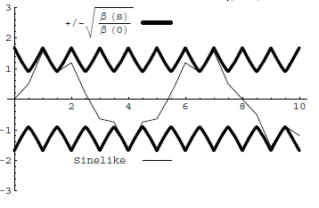
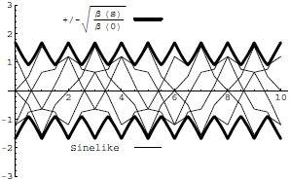
Conceptual understanding of β
It’s important to remember that the betatron function represents a bounding envelope to the beam motion, not the beam motion itself
Normalized particle trajectory
Trajectories over multiple turns
β(s) is also effectively the local wave number which determines the rate of phase advance
Closely spaced strong quads ➔ small β ➔ small aperture, lots of wiggles
Sparsely spaced weak quads ➔ large β ➔ large aperture, few wiggles

Slide 33
Betatron Tune
Particle trajectory
As particles go around a ring, they will undergo a number of betatrons oscillations ν (sometimes Q) given by
This is referred to as the “tune”
Ideal orbit
We can generally think of the tune in two parts:
6.7
Integer : magnet/aperture optimization
Fraction: Beam Stability

Slide 34
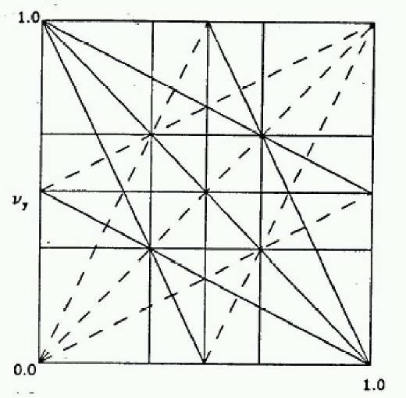
Tune, Stability, and the Tune Plane
If the tune is an integer, or low order rational number, then the effect of any imperfection or perturbation will tend be reinforced on subsequent orbits.
When we add the effects of coupling between the planes, we find this is also true for combinations of the tunes from both planes, so in general, we want to avoid
Many instabilities occur when something perturbs the tune of the beam, or part of the beam, until it falls onto a resonance, thus you will often hear effects characterized by the “tune shift” they produce.
“small” integers
➔Avoid lines in the “tune plane”
fract. part of Y tune
fract. part of X tune

Slide 35
Characterizing an Ensemble: Emittance
If each particle is described by an ellipse with a particular amplitude, then an ensemble of particles will always remain within a bounding ellipse of a particular area:
Area = ε
Either leave the π out, or include it explicitly as a “unit”. Thus
microns (CERN) and
π-mm-mr (FNAL)
Are actually the same units (just remember you’ll never have to explicity use π in the calculation)
These are really the same

Slide 36
Definitions of Emittance
Because distributions normally have long tails, we have to adopt a convention for defining the emittance. The two most common are
Gaussian (electron machines, CERN):
95% Emittance (FNAL):
In general, emittance can be different in the two planes, but we won’t worry about that.

Slide 37
Emittance and Beam Distributions
As we go through a lattice, the bounding emittance remains constant
large spatial distribution
small angular distribution
small spatial distribution
large angular distribution

Slide 38
Adiabatic Damping
In our discussions up to now, we assume that all fields scale with momentum, so our lattice remains the same, but what happens to the ensemble of particles? Consider what happens to the slope of a particle as the forward momentum incrementally increases.
If we evaluate the emittance at a point where α=0, we have
“Normalized emittance”
=constant!

Slide 39
Consequences of Adiabatic Damping
As a beam is accelerated, the normalized emittance remains constant
Actual emittance goes down down
Which means the actual beam size goes down as well
The angular distribution at an extremum (α=0) is
We almost always use normalized emittance
betatron function
RMS emittance
95% emittance
v/c

Slide 40
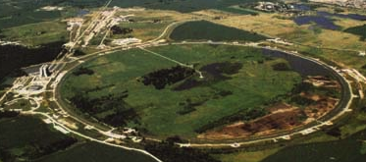
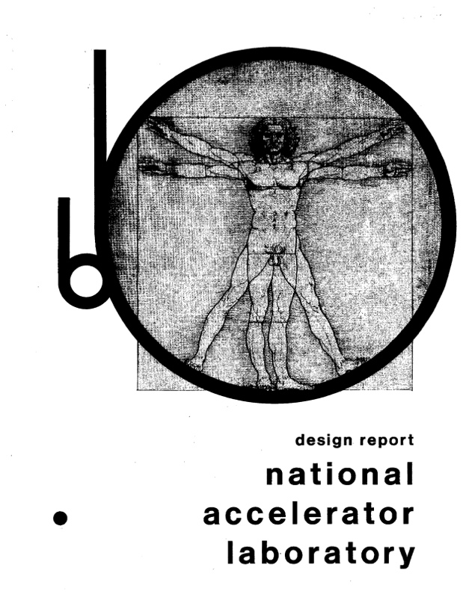
Example: Fermilab Main Ring
First “separated function” lattice
1 km in radius
First accelerated protons from 8 to 400 GeV in 1972
1968

Slide 41
Beam Parameters
The Main Ring accelerated protons from kinetic energy of 8 to 400 GeV*
Parameter | Symbol | Equation | Injection | Extraction
proton mass | m [GeV/c²] |  | 0.93827
kinetic energy | K [GeV] |  | 8 | 400
total energy | E [GeV] |  | 8.93827 | 400.93827
momentum | p [GeV/c] |  | 8.88888 | 400.93717
rel. beta | β |  | 0.994475 | 0.999997
rel. gamma | γ |  | 9.5263 | 427.3156
beta-gamma | βγ |  | 9.4736 | 427.3144
rigidity | (Bρ) [T-m] |  | 29.65 | 1337.39
*remember this for problem set

Slide 42


Cell Parameters
From design report
L=29.74 m
Phase advance μ=71°
Quad Length l_{quad}=2.13 m
Beta functions (slide 36)
Magnet focal length
Quad gradient (slide 12)

Slide 43
Beam Line Calculation: MAD
We could calculate α(s),β(s), and γ(s) by hand (slide 25) , but…
There have been and continue to be countless accelerator modeling programs; however MAD (“Methodical Accelerator Design”), started in 1990, continues to be the “Lingua Franca”
98.4m (exact) vs. 99.4m (thin lens)
main_ring.madx
!
! One FODO cell from the FNAL Main Ring (NAL Design Report, 1968)
!
beam, particle=proton,energy=400.938272,npart=1.0E9;
LQ:=1.067;
LD:=29.74-2*LQ;
qf: QUADRUPOLE, L=LQ, K1=.0195;
d: DRIFT, L=LD;
qd: QUADRUPOLE, L=LQ, K1=-.0195;
fodo: line = (qf,d,qd,qd,d,qf);
use, period=fodo;
match,sequence=FODO;
SELECT,FLAG=SECTORMAP,clear;
SELECT,FLAG=TWISS,column=name,s,betx,alfx,bety,alfy,mux,muy;
TWISS,SAVE;
PLOT,interpolate=true,,colour=100,HAXIS=S, VAXIS1=BETX,BETY;
PLOT,interpolate=true,,colour=100,HAXIS=S, VAXIS1=ALFX,ALFY;
stop;
half quad
K1=1/(2f)
24.7m vs. 26.4m
build FODO cell
force periodicity
calculate Twiss parameters

Slide 44
Beam Sizes
We normally use 95% emittance at Fermilab, and 95% normalized emittance of the beam going into the Main Ring was about 12 π-mm-mr, so the normalized RMS emittance would be
We combine this with the equations (slide 45), beam parameters (slide 47) and lattice functions (slide 48) to calculate the beam sizes at injection and extraction.
We have divided out the “π”
Parameter | Symbol | Equation | Injection | Extraction
kinetic energy | K [GeV] |  | 8 | 400
beta-gamma | βγ |  | 9.4736 | 427.3144
normalized emittance |  |  | 2x10⁻⁶
beta at QF |  |  | 99.4
beta at QD |  |  | 26.4
x size at QF |  |  | 4.58 |  | .68
y size at QF |  |  | 2.36 |  | .35
x ang. spread at QF |  |  | 46.1x10⁻⁶ |  | 6.9x10⁻⁶
y ang. spread at QF |  |  | 89.5x10⁻⁶ |  | 13.3x10⁻⁶

Slide 45
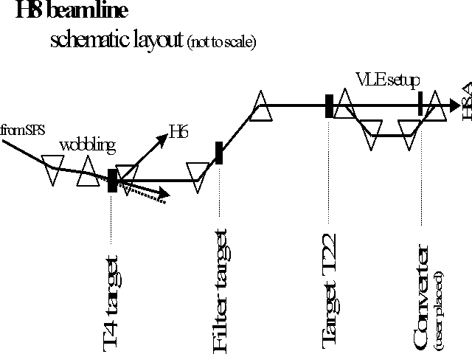
Beam Lines
In our definition and derivation of the lattice function, a closed path through a periodic system. This definition doesn’t exist for a beam line, but once we know the lattice functions at one point, we know how to propagate the lattice function down the beam line.

Slide 46
Establishing Initial Conditions
When extracting beam from a ring, the initial optics of the beam line are set by the optics at the point of extraction.
For particles from a source, the initial lattice functions can be defined by the distribution of the particles out of the source

Slide 47
Mismatch and Emittance Dilution
In our previous discussion, we implicitly assumed that the distribution of particles in phase space followed the ellipse defined by the lattice function
Once injected, these particles will follow the path defined by the lattice ellipse, effectively increasing the emittance
Lattice ellipse
…but there’s no guarantee
What happens if this it’s not?
Area = ε
Injected particle distribution
Effective (increased) emittance

Slide 48
Modeling FODO Cells in g4beamline
In spite of the name, g4beamline is not really a beam line tool.
Does not automatically handle recirculating or periodic systems
Does not automatically determine reference trajectory
Does not match or directly calculate Twiss parameters
Fits particle distributions to determine Twiss parameters and statistics.
Nevertheless, it’s so easy to use, that we can work around these shortcomings
Create a series of FODO cells
Carefully match our initial particle distributions to the calculations we just made.

Slide 49
Creating a Line of FODO Cells
We’ve calculated everything we need to easily create a string of FODO cells based on the Main Ring
Won’t worry about bends
Phase advance per cell = 71°, so need at least at least ~5 cells to see one betatron period. Let’s do 8.
First, create a quadrupole
# Main Ring FODO cell
param L=29740.
param QL=2133.3
param aperture=50. # Not really important
param -unset gradient=24.479
param -unset nCell=8
genericquad MRQuad fieldLength=$QL ironLength=$QL apertureRadius=$aperture ironRadius=5*$aperture kill=1
kill=1 saves time if you make a mistake!
Doesn’t really look like a real quadrupole, but the field is right and that’s all that matters.

Slide 50
Create string of FODOs
Create 8 cells by putting 16 of these, spaced 29740 mm apart, with alternating gradients (good practice for doing loops in g4bl).
If we put the first quad at z=0., the beam will start the middle of it. Is this what we want? Why or why not?
We create a Gaussian beam based on the parameters we calculated on Slide 50
We want to track the first hundred particles individually, so we add
We want to fit the distributions at regular intervals to calculate the beam widths and Twiss parameters. so we add the lines
Now run 1000 events
Need enough for robust fits
beam gaussian sigmaX=.682 sigmaXp=.00000686 sigmaY=.351 sigmaYp=.00001332 \
meanMomentum=$P nEvents=$nEvents particle=proton
trace nTrace=100 oneNTuple=1 primaryOnly=1
param totlen=2*$nCell*$L
profile zloop=0:$totlen:100 particle=proton file=main_ring_profile.txt

Slide 51
Analyze Output
The individual track information is written to the standard root output file in an Ntuple called “AllTracks”
The profile information is written to a text file. This can be read directly into histoRoot. I’ve provided a class (G4BLProfile) to load it into root*
We want to create a plotting space on which we can overlay several plots. The easiest way I know do to this is an empty 2D histogram.
Overlay a 3 sigma “envelope”, based on the fitted profiles
TFile ft("g4beamline.root");
TNtuple *t = (TNtuple *) ft.FindObjectAny("AllTracks");
G4BLProfile fp(filename);
TNtuple *p = fp.getNtuple();
TH2F plot("plot","Track Trajectories",2,0,sMax,2,-xMax,xMax);
plot.SetStats(kFALSE); //turn off annoying stats box
plot.Draw();
p->Draw("3*sigmaX:Z","","same");
p->Draw("-3*sigmaX:Z","","Same");
“same” option draws over existing plot
*http://home.fnal.gov/~prebys/misc/NIU_Phys_790/

Slide 52
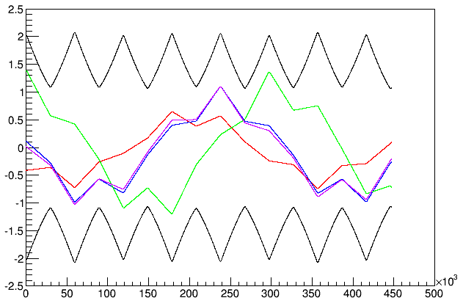
Plot Individual Tracks
t->SetMarkerColor(kRed); // These are points, not lines
t->Draw("x:z","EventID==1","same");
...

Slide 53
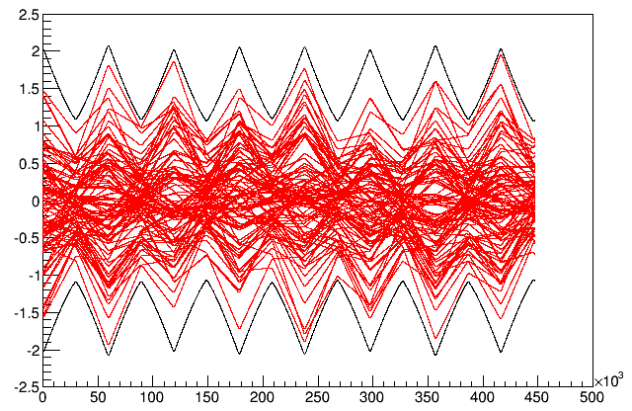
Envelopes
If we overlay all 100 tracks (remove “EventID” cut), we see that although each track has a periodicity of ~5 cells, the envelope has a periodicity of one cell..

Slide 54
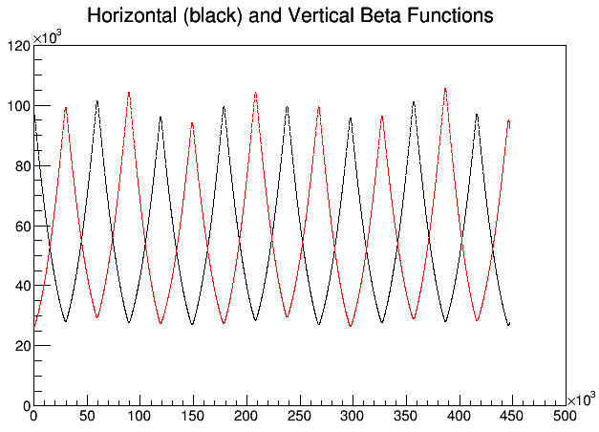
Lattice Functions
We can plot the fitted lattice functions and compare them to our calculations.
TH2F beta("beta","Horizontal (black) and Vertical Beta Functions",2,0.,sMax,2,0.,120000.);
beta.SetStats(kFALSE);
beta.Draw();
p->Draw("betaX:Z","","same");
p->SetMarkerColor(kRed);
p->Draw("betaY:Z","","same");
beta functions in mm!
slight mismatch because of thin lens approximation

Slide 55
Mismatch and Emittance Dilution
In our previous discussion, we implicitly assumed that the distribution of particles in phase space followed the ellipse defined by the lattice function
Once injected, these particles will follow the path defined by the lattice ellipse, effectively increasing the emittance
Lattice ellipse
…but there’s no guarantee
What happens if this it’s not?
Area = ε
Injected particle distribution
Effective (increased) emittance

Slide 56
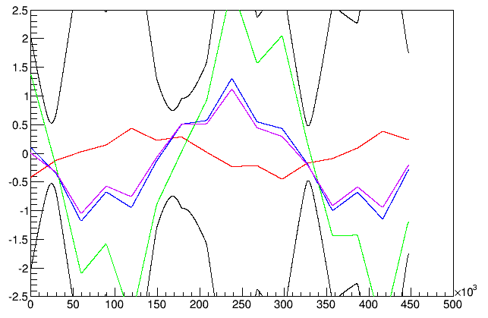
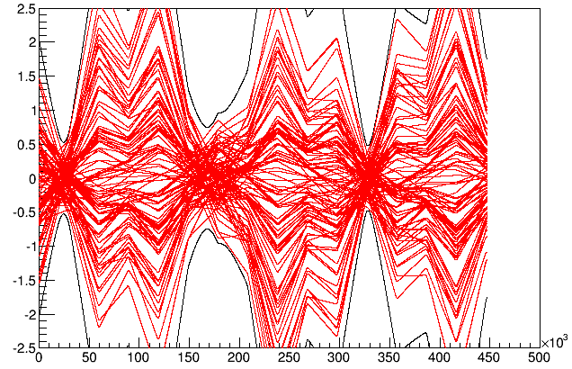
How Important is Matching?
In our example, we carefully matched our initial distributions to the calculated lattice parameters at the center of the magnet. If we start these same distributions just ~1m upstream, at the entrance to the magnet, things aren’t so nice.
Individual track trajectories look similar (of course)
Envelope looks totally crazy

Slide 57
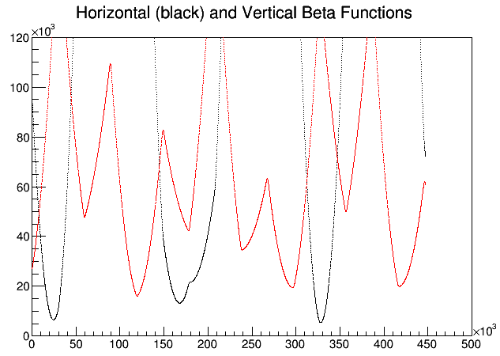
Effect of Mismatching on Lattice Parameters
If we fit the beta functions of these distributions, we see that the original periodicity is completely lost now.
Therefore, lattice matching is very important when injecting, extracting, or transitioning between different regions of a beam line!

